Slide 2


Slide 3


Slide 4


Slide 5


Slide 6
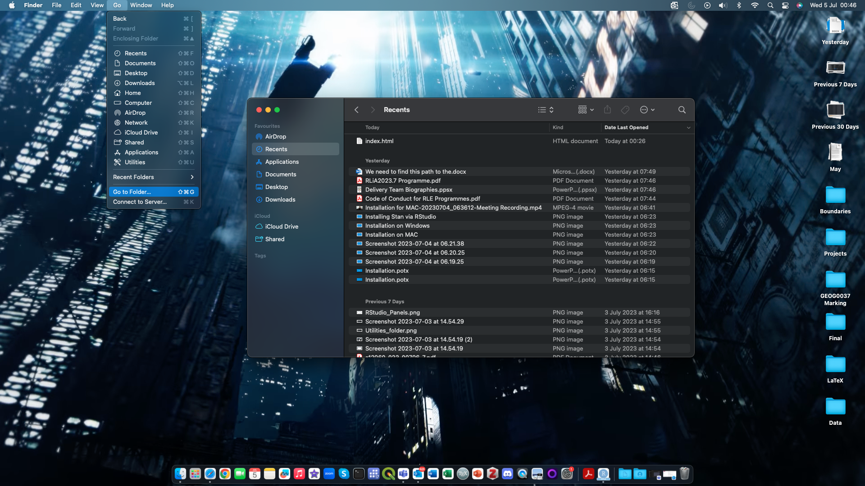
2. Click on “Go”
3. Click on “Go to Folder”
1. Click on “Finder” app icon

Slide 7
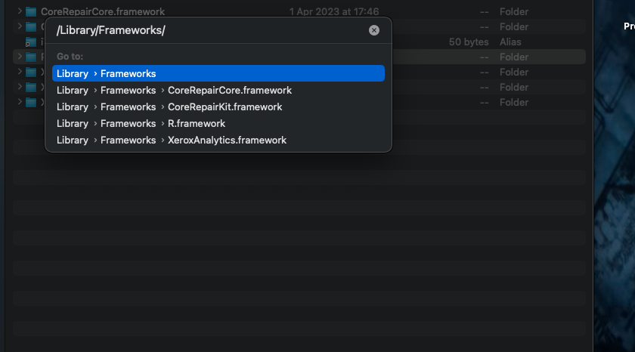
4. This box panel will appear.
As you see here, type ”/Library/Frameworks/”. Press enter and it will direct you to this “Frameworks” folder.
Delete the “R.framework” folder in the list.

Slide 8
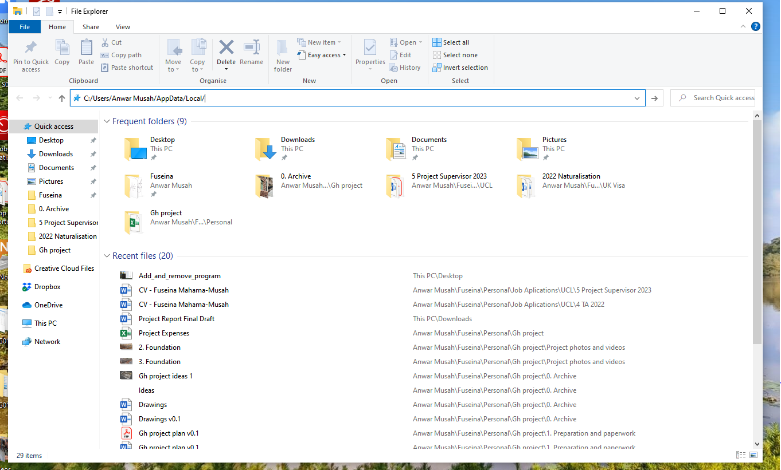
5. Type the path “C:\Users\Your_username\AppData\Local” in this search bar in the File Explorer window. It should take you to the “Local” folder. Here, delete the following folders if you see them: “R”, “RStudio” and/or “RStudio-Desktop”.
6. Repeat the steps in 5 by typing the path “C:\Program Files” in this search bar. It should take you to the “Program Files” folder. Again, check and delete any folders that’s “R”, “RStudio” and/or “RStudio-Desktop”.
Do the same by also checking the folder “Program Files (x86)” using this path “C:\Program Files (x86)” and delete accordingly.

Slide 9
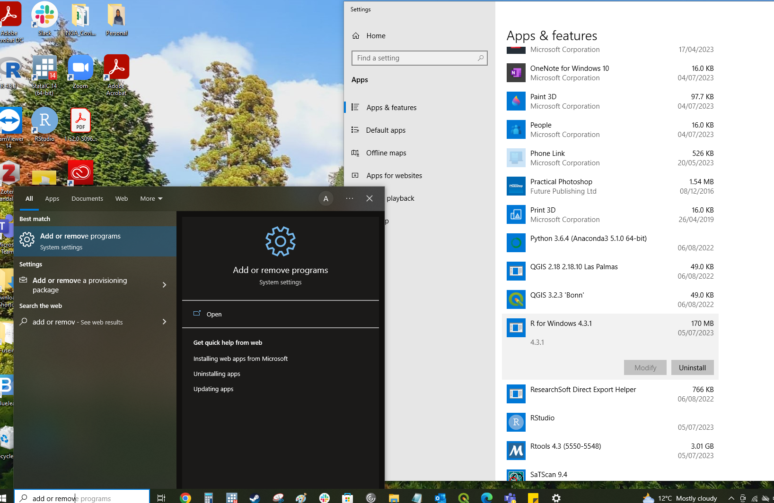
2. The “Add or remove programs” settings should appear. Click it to show “Apps & Features” window
3. Under this section – completely uninstall R (4.3.x)
4. Repeat the third steps for removing RStudio and Rtools 4.3.
1. Type “Add or remove programs” in search bar

